Slide 2
Digital Forensics Lecture-23
By- Dr.subhranil Das
Assistant Professor
School of computer Science

Slide 3

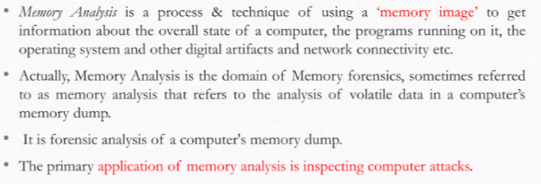
Memory Analysis

Slide 4
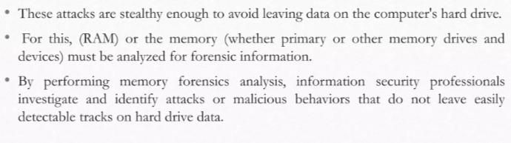
Memory Analysis

Slide 5
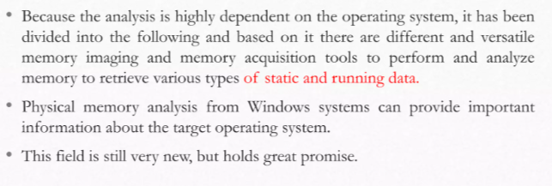
Memory Forensics

Slide 6
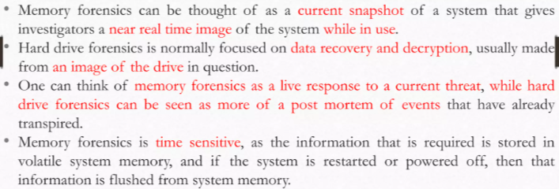
How the memory forensics id different from hardware forensics?

Slide 7
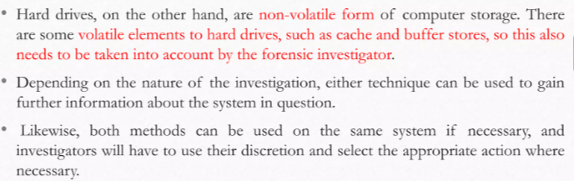
How the memory forensics is different from hardware forensics?

Slide 8
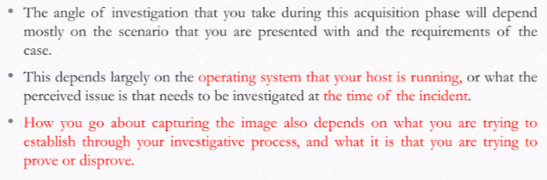
Different methods of acquisition in memory

Slide 9
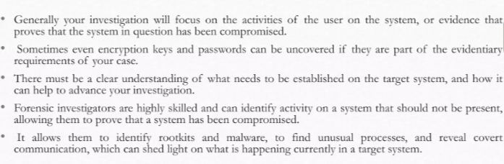
Different methods of acquisition in memory

Slide 10
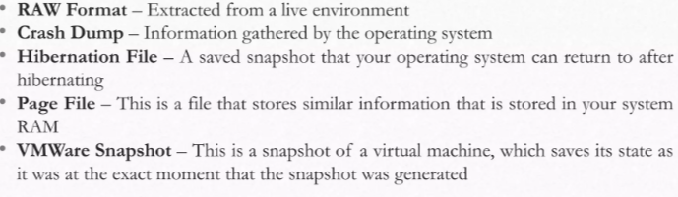
Examples of Memory Acquisition

Slide 11
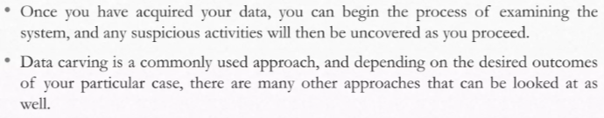
Examples of Memory Acquisition

Slide 12
Next Lecture
Memory Imaging
.

